Slide 1
REVIEW on PEP, RE-IPCC, and Energy Efficiency
By: Ivan John Naparota
MSEE Student
USC

Slide 2
PEP (2017-2040) see DOE page for the document
An initiative by the Philippine Gov’t that started from the term of Pres. Aquino and now being continued by the present president, it basically aims to have a sustainable energy for the country.
Philippines’ present condition (as of 2016):
Self – sufficiency: 55.3%
Total Installed Capacity: 21,424 MW (32.5 % RE)
Total Generation: 90, 797 GWh (46.1% RE and Nat gas)
Deliverables: Ensure energy security, expand energy access, promote low carbon (energy efficiency and conservation, RE’s), strengthen collaboration on gov’t agencies related to energy

Slide 3
Review
Upon seeing the country’s present condition with regards to energy as presented in PEP (2017-2040), there is really a need for initiatives from the gov’t, private sector, substantially everyone to solve present issues of sustainable energy, it is good to see the noble deliverables of the PEP, and hopefully the country can achieve those on the said target time. But there is something in PEP that is bugging me, even with the fact that PEP is promoting a future with low carbon its projected outlook by 2040 is somewhat the irony. Let’s take a look at a snipped graph of the PEP’s outlook by 2040.

Slide 4
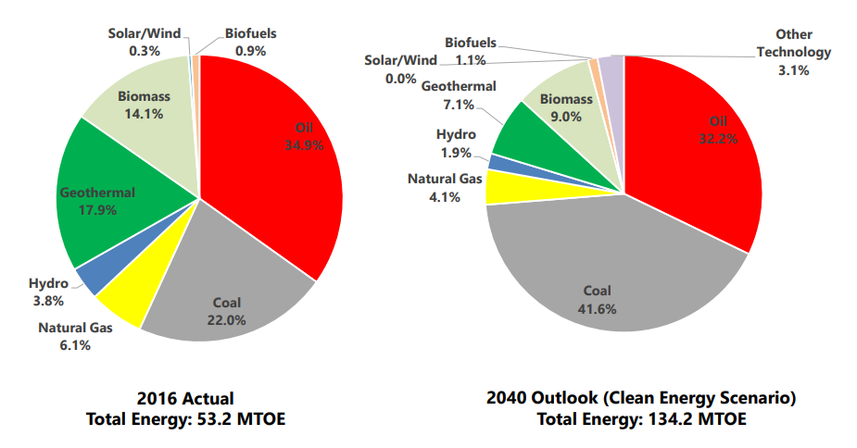
It is surely sighting for that almost tripled total energy but please take time to look at the percentage of the coal that is being planned to attain by the PEP, the coal’s usage is almost doubled, I shouldn’t be surprised

Slide 5
knowing our president, he is very vocal on his stand regarding coal energy because of his aim for industrialization for the Philippines, but as a professional that knows a pinch of knowledge about energy, coal is surely not the path to go if we are aiming for a sustainable energy, first it’s not renewable having a finite source for fuel, second it’s not clean, I know that Philippines is not that a major contributor for climate change because of our energy mix and knowing that we have a small load compared to other big countries, but still, coal is coal, carbon emission cannot be disregarded in this energy source, there are still many sources out there that can sail our country towards industrialization without resorting to carbon contributing energy sources.
This is the only point in this PEP that bothers me, or maybe there could be other points but upon reading it for a short time, this point floats out obviously over the other.

Slide 6
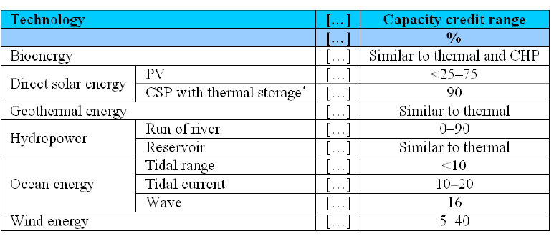
RE IPCC REVIEW ()
All I see are positive things about RE’s, from the obvious point, that RE’s are reported to have lower GHG emissions than the conventional fossil fuel sources to the surprising ones, that some RE’s like concentrated solar power that has thermal storage can be dependent during high demand periods knowing that RE’s has intermittent sources. See photo below: This only shows that RE’s
can be dependable if storage of energy is done.

Slide 7
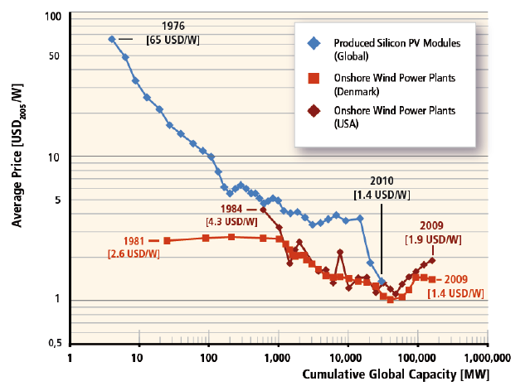
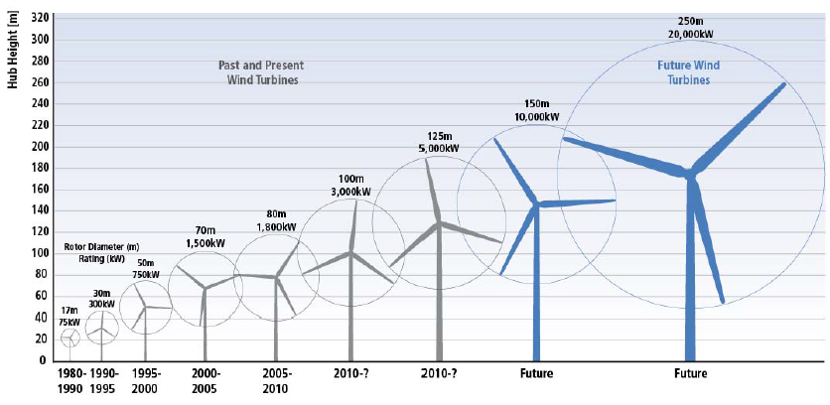
Another positive point is that the innovations of wind turbines, it’s size is growing over the years which is directly proportional to its power capacity, another one is the fact that even if the cost of RE’s are higher than other energy sources, the trend of its price is declining over the years and is expected to further decline in the future.

Slide 8
Overall, though RE’s still need innovations in some aspects to it like storage technology to solve its intermittency, I am glad to have this kind of reports, it’s a little daylight to the doom that carbon has brought to the earth’s well being.
And also, it is reported in the RE IPCC report that Philippines are one of those countries that has at least one RE National Policy and at least one RE target, that’s a good sign for the Philippines’ chase for sustainable energy.
Reference: https://www.ipcc.ch/pdf/special-reports/srren/ipcc-srren-generic-presentation-1.pdf

Slide 9
Case studies
Energy Efficiency
Energy efficiency as a whole is an initiative that has a goal to limit the usage of energy, with this, we cannot contribute to the world’s excessive usage of energy, that will in most cases result to GHG emissions. Along with renewable energy, energy efficiency are one of those key points to tackle in the chase for sustainable energy. If RE is in the supply side, EE is in the demand side.
According to ESMAP, about one third of global energy is consumed in residential, public, and commercial (collectively known as buildings). Because of their heavy consumptions, buildings offer a very big opportunity for energy savings. According to International Energy Agency, buildings account for 41% of global energy savings potential by 2035.
And in reality, Philippines is lagging significantly in the aspect of Energy Efficiency compared to other countries, that is why I will take time to study this potential case study for my thesis ☺, maybe making a simulation-based energy efficient building template that is ready for implementation.

Slide 10
EEB in the country has still a long way to go to par with other countries, researchers well equipped with knowledge regarding about this is substantially needed.

